Slide 1
Final Year Project July 2024-May 2025

Slide 2
CLOUDARA – Hosting Platform
Supervisor: Mr. Sumit Kumar
Team Members:
Arjun Bhardwaj (21csu211)
Aditya Narain Jha (21csu129)
Laishram Siddarth (21csu216)
Yash Sharma (21csu269)
Computer Science (Full Stack Development)

Slide 3
Description Of The Topic
Website hosting faces a cost-performance dilemma: dedicated services are reliable but expensive, while affordable options like AWS Spot Instances lack consistency. CLOUDARA addresses this by creating an automated, scalable web deployment framework that optimizes both cost and performance.
While containerization has revolutionized deployment flexibility through platforms like AWS ECS and Docker, efficient resource management remains challenging. CLOUDARA leverages AWS Spot Instances to reduce costs and maintains service continuity through Cedana's checkpointing and migration system. Unlike traditional hosting solutions, CLOUDARA offers comprehensive real-time analytics via Kafka and ClickHouse, enabling users to monitor deployment performance effectively.

Slide 4
Feasibility Study
Technical Feasibility: The project is built using widely adopted and robust technologies such as Node.js, Kafka, and ClickHouse. AWS ECS ensures scalable deployment, and Cedana enables seamless instance migrations.
Economic Feasibility: By leveraging Spot Instances, CLOUDARA reduces infrastructure costs by over 50% compared to dedicated instances, making it a viable alternative for cost-conscious developers and businesses.
Operational Feasibility: The system is designed for automation, requiring minimal manual intervention. The integration of real-time logging, analytics, and automated checkpointing enhances usability and efficiency
Through these advancements, CLOUDARA provides a competitive edge over traditional web hosting services by combining automation, cost-effectiveness, and resilience, ensuring a seamless deployment experience for developers and enterprises alike.

Slide 5
Existing Solutions/Literature Review
Traditional CI/CD Limitations:
Forced choice between expensive dedicated infrastructure or unreliable shared environments
Basic logging without real-time high-throughput capabilities
Poor analytics for build failures and deployment performance
Lack of automated resilience when using cost-effective Spot Instances
Complete restarts required when instances are lost
CLOUDARA's Solutions:
Containerized deployments via AWS ECS for flexibility and efficiency
Real-time log management through Kafka for high-throughput data handling
Advanced analytics with ClickHouse for comprehensive performance monitoring
Cedana integration for minimal downtime with cost-effective Spot Instances
Automated resilience mechanisms that eliminate full restarts when instances fail

Slide 6
GAPS in existing solution/literature review
Current Limitations in Deployment Solutions
Cost vs. Reliability Trade-off: Dedicated infrastructure costs more; shared environments lack reliability
Limited Log Capabilities: Basic or inefficient log tracking at scale
Analytics Shortfall: Insufficient real-time monitoring tools
Poor Resilience: No automated failover for cost-effective Spot Instances
Performance Issues: Downtime when instances are interrupted
CLOUDARA's Solutions
50%+ Cost Reduction: Leveraging AWS Spot Instances
Continuous Availability: Cedana integration for automated checkpointing and migration
Superior Log Management: Kafka implementation for high-throughput streaming
Optimized Data Storage: ClickHouse database for rapid querying of massive datasets
Performance Intelligence: Real-time analytics for build failures and system performance insights

Slide 7
Problem Statement
In today's digital landscape, organizations face a critical dilemma when deploying web applications: choose expensive dedicated infrastructure for reliability or accept the unpredictability of more affordable shared resources. This cost-reliability tradeoff is compounded by inadequate real-time monitoring capabilities across most platforms, making performance optimization difficult. Furthermore, conventional CI/CD tools lack automated recovery mechanisms for cost-effective Spot Instances, resulting in significant downtime when instances fail. These limitations force businesses to either overpay for stability or accept service disruptions—neither of which is sustainable in an environment where both operational efficiency and consistent performance are essential for success.

Slide 8
Objectives
Deployment Automation:
API-driven Node.js system for seamless Git repository deployment
AWS ECS for isolated containerization and efficient parallel processing
Cost Optimization:
AWS Spot Instances to significantly reduce infrastructure costs
Cedana integration for checkpointing to prevent resource-intensive rebuilds
Advanced Monitoring:
Kafka implementation for high-throughput log streaming
ClickHouse database for optimized real-time analytics
System Resilience:
Self-healing architecture with automated instance recovery
Minimal downtime through state-based resumption
Developer Experience:
Intuitive interface requiring minimal cloud expertise
Real-time deployment status and accessible log retrieval

Slide 9
Tools/platform Used
Backend: Node.js (RESTful API server) for handling deployment requests and managing container orchestration.
Deployment: AWS ECS (Elastic Container Service) to dynamically create and manage containers for isolated builds and deployments.
Storage: AWS S3 for storing built outputs, ensuring a cost-effective and scalable storage solution.
Database: ClickHouse (hosted on Aiven) for managing structured data related to deployments, user configurations, and system metadata.
Logging System: Kafka replaced Redis for real-time log streaming, ensuring high-throughput event processing.

Slide 10
Tools/platform Used
Analytics: ClickHouse (columnar database) to store and process logs efficiently, allowing high-speed Checkpointing & Migration: Cedana to handle AWS Spot Instance interruptions by saving instance states querying for real-time insights and enabling seamless recovery.
Reverse Proxy: Custom-built proxy for fetching and serving content stored in S3, optimizing performance and security.
Monitoring & Polling: Kafka consumer processes logs and inserts them into ClickHouse, enabling efficient data retrieval and analysis.

Slide 11
Design Methodology
Research and Requirement Gathering:
Analyzed existing CI/CD tools to identify gaps in cost-efficiency, scalability, and reliability.
Selected AWS ECS for containerized deployments, Kafka for real-time log streaming, and Cedana for instance checkpointing.
Defined core objectives: reducing infrastructure costs, improving deployment speed, and ensuring minimal downtime
Conceptualization:
Designed a modular architecture integrating Node.js, PostgreSQL, Kafka, ClickHouse, and AWS services.
Created workflow diagrams and system models to visualize deployment, logging, and failover mechanisms.
Wireframing and Prototyping:
Implemented containerized deployments with AWS ECS, ensuring parallel execution and isolated builds.
Replaced Redis with Kafka for log management and ClickHouse for high-speed analytics.
Conducted integration, and load testing to ensure system reliability and performance.

Slide 12
Design Methodology
Development and Testing:
Deployed the production-ready system with automated scaling and monitoring tools.
Implemented real-time logging, error tracking, and user feedback collection for continuous improvement.
Optimized resource utilization and cost efficiency by refining Spot Instance allocation and checkpointing strategies.
Launch and Post-Launch Support:
Deployed the system with AWS ECS, ensuring smooth containerized deployments and failover mechanisms.
Set up monitoring tools to track performance, detect failures, and optimize resource allocation.
Gathered user feedback, analyzed system logs, and iterated on improvements for enhanced efficiency and scalability.

Slide 13
Challenges and Issues identified
Area | Challenge | Solution
Pipeline & Rollback | Needed custom steps with auto recovery | Built plugin system + ECS tasks + S3 rollback
Spot Instance Resilience | Spot terminations disrupted builds | Used Cedana for fast checkpoint & restore
Logging & Analytics | High-volume logs needed real-time visibility | Kafka + ClickHouse pipeline with backpressure control
Monitoring & Alerts | Required live metrics & alerting | React dashboard + WebSocket + Slack/Email alerts
Access Control | Secure multi-tenant access with roles | OAuth + PostgreSQL RBAC + audit logs

Slide 14
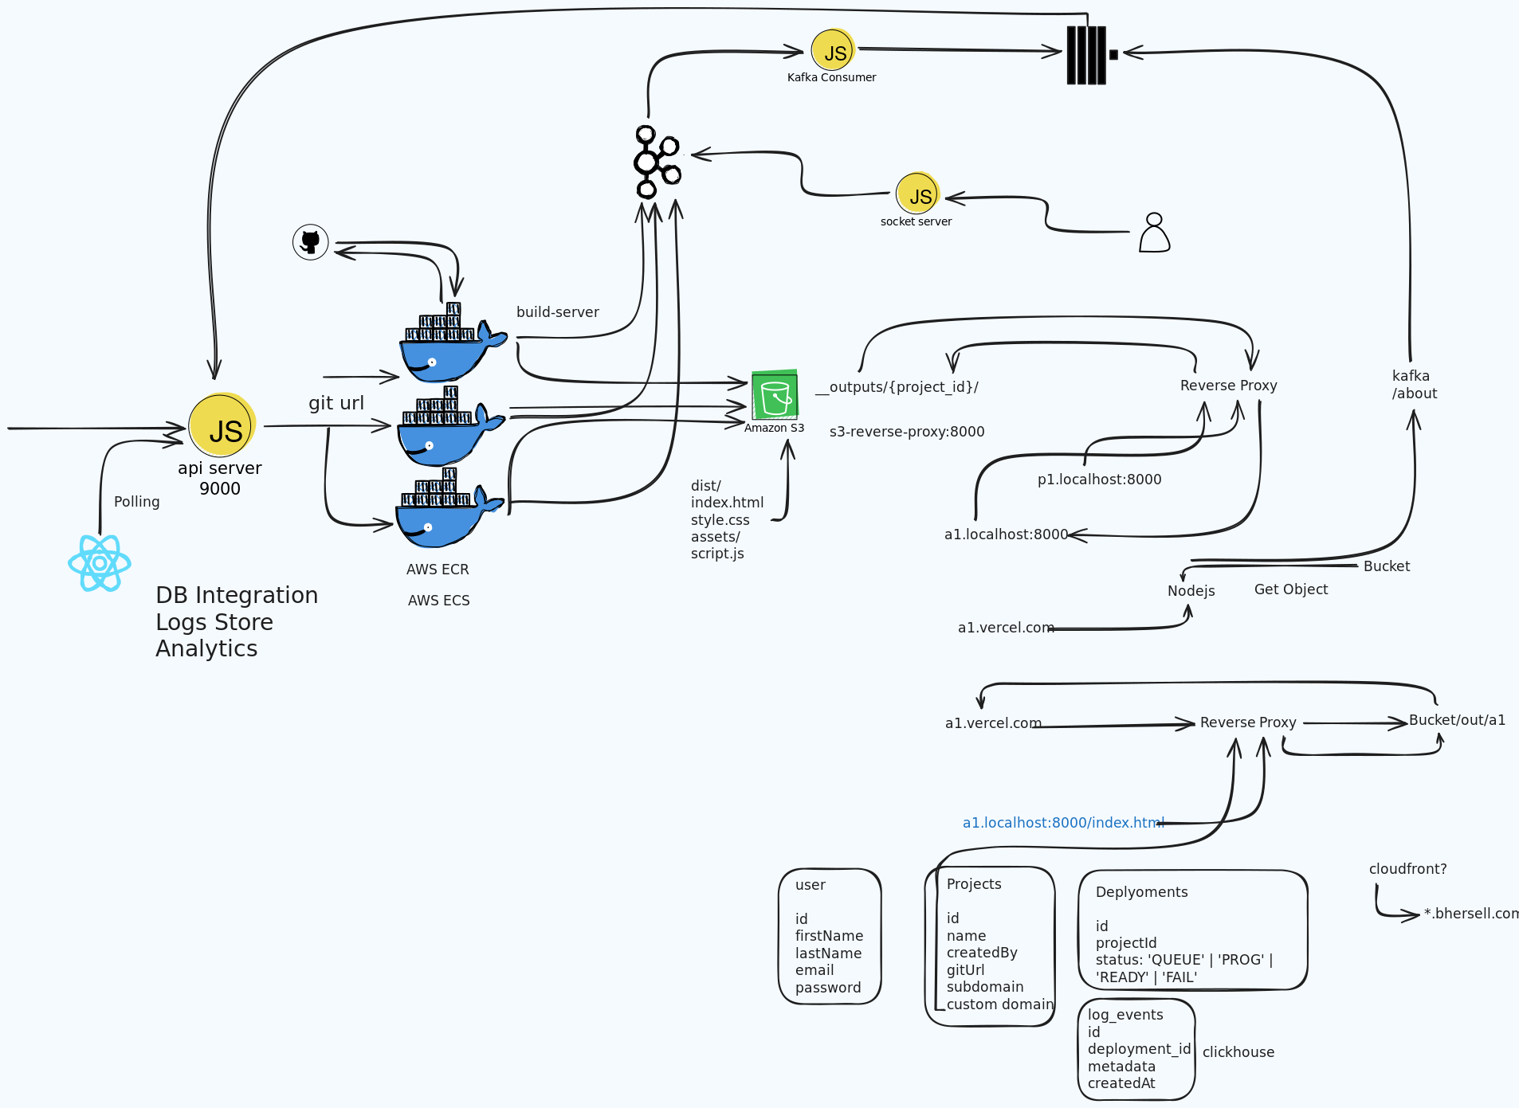
Methodology & Implementation/ Interface and Design Implementation

Slide 15
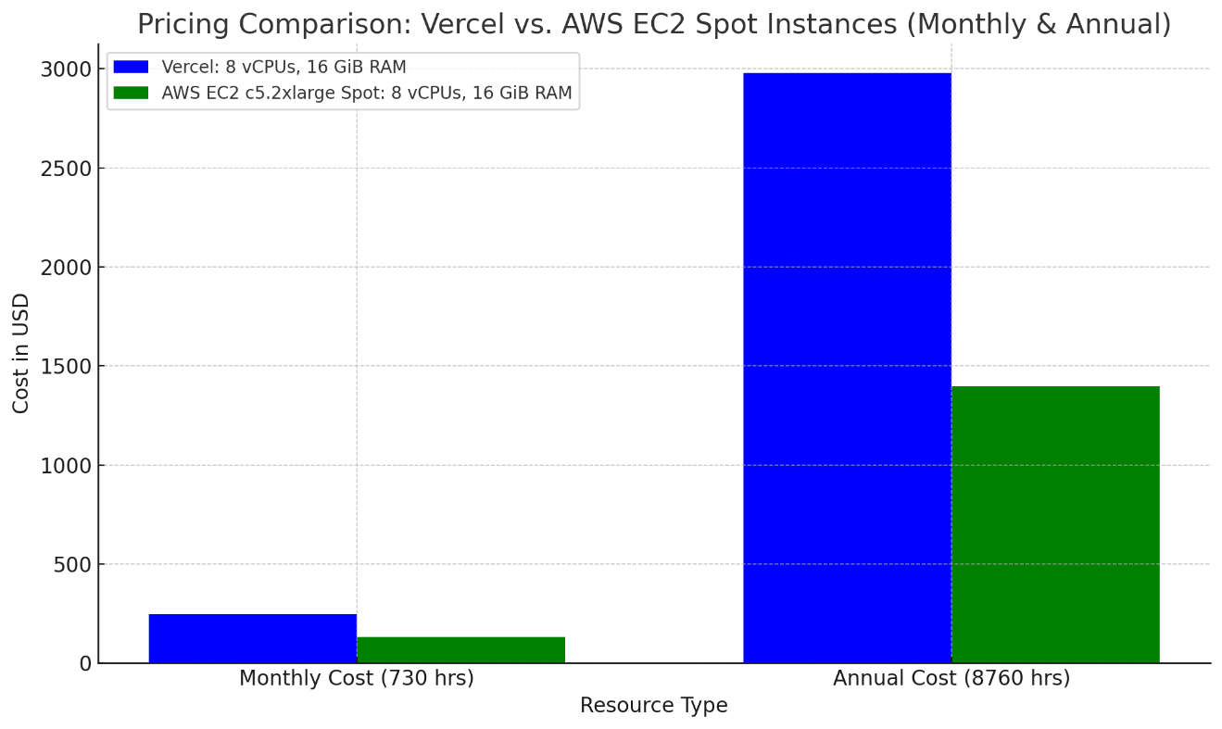
Testing and Performance Evaluation

Slide 16
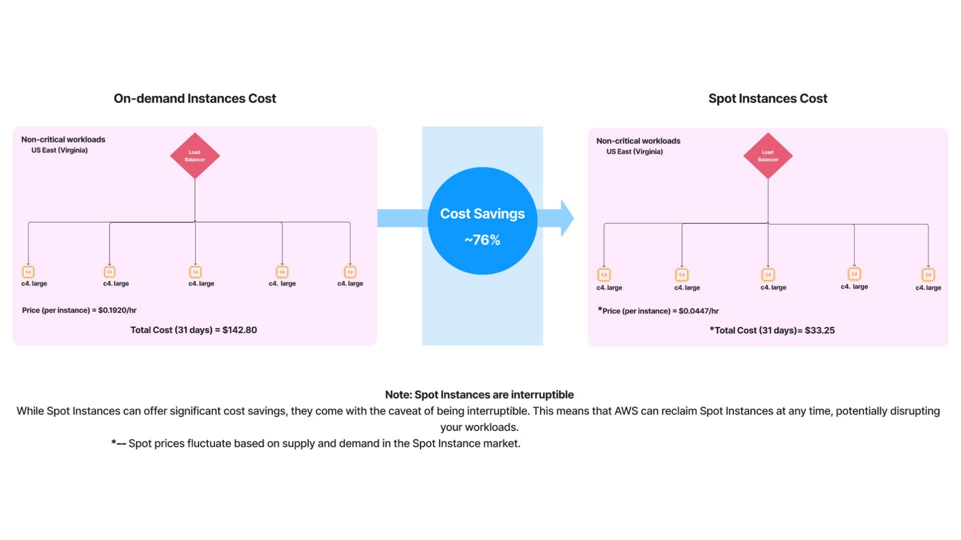
Testing and Performance Evaluation

Slide 17
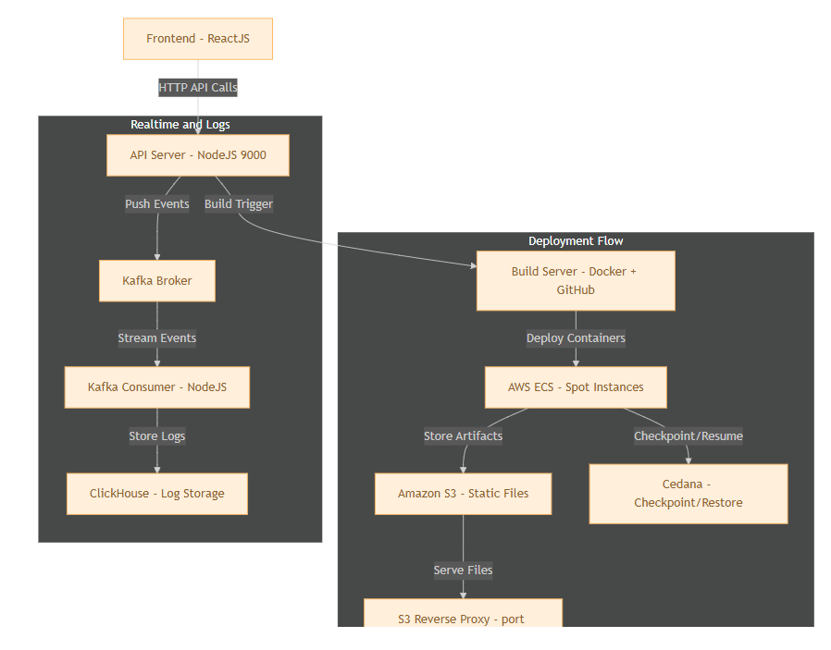
ARCHITECTURE DIAGRAM

Slide 18
Expected Outcome of Project
Streamlined Deployment Infrastructure:
Automated Pipeline: Seamless Git repository deployment without manual intervention
Isolated Containerization: Conflict-free deployments using AWS ECS
Parallel Processing: Multiple simultaneous deployments for enhanced efficiency
Cost-Performance Optimization:
50%+ Infrastructure Savings: AWS Spot Instances vs. on-demand pricing
Continuous Availability: Cedana's checkpointing prevents costly rebuilds
Resource Efficiency: Optimized container utilization and storage management
Advanced Monitoring & Analytics:
High-Throughput Logging: Kafka implementation replaces Redis limitations
Persistent Data Storage: ClickHouse enables efficient historical analysis
Real-Time Insights: Performance monitoring for rapid issue identification

Slide 19
Expected Outcome of Project
Enhanced Resilience & User Experience:
Self-Healing Architecture: Automatic recovery from instance failures
Minimal Downtime: Checkpoint-based restoration ensures service continuity
Developer-Friendly Interface: Simplified deployment with real-time progress feedback
Future-Ready Design:
Modular Architecture: Ready for CI/CD enhancements and multi-region expansion
AI Integration Pathway: Foundation for machine learning-based optimizations

Slide 20
Conclusion and Future Scope
Conclusion:
Successfully built a cost-efficient, high-availability cloud deployment system leveraging containerization, Spot Instances, and real-time analytics.
Achieved automated recovery, fast rollbacks, and seamless developer workflows through modular microservices and event-driven architecture.
Real-time dashboards and logging improved observability and developer responsiveness during deployment cycles.
Future Scope:
Multi-cloud Support: Extend support to GCP & Azure for broader infrastructure flexibility.
AI-based Optimization: Integrate ML models to predict Spot terminations and optimize resource allocation.
Self-healing Pipelines: Automate intelligent step retries and dynamic workflow branching.
Security Enhancements: Add deeper compliance modules (e.g., SOC2, ISO 27001).
Mobile-Friendly Monitoring: Build a lightweight mobile UI for deployment tracking on the go.

Slide 21
References
https://aws.amazon.com/ecr/
https://docs.aws.amazon.com/AmazonECR/latest/userguide/Registries.html
https://aws.amazon.com/ecs/
https://docs.aws.amazon.com/AmazonECS/latest/developerguide/Welcome.html
https://www.docker.com/
Apache Kafka® service
ClickHouse® service
https://aiven.io/
https://aws.amazon.com/docker/
https://cedana.substack.com/p/using-cedana-to-live-migrate-stateful

Slide 22
Responsibility Chart
Team Roles | Responsibility
Project Lead | Overall Project Supervision
API Developer | Node.js API Integration
Docker Management | Docker container setup and management
AWS Specialist | ECS and S3 integration
Log Manager | Kafka integration and log monitoring

Slide 23
GANTT Chart
Task | Duration | Start Date | End Date
Research & Planning | 6 weeks | 01-Oct | 12-Nov
API & Docker Setup | 8 weeks | 13-Nov | 7-Jan
AWS ECS Integration | 6 weeks | 8-Jan | 18-Feb
Redis & Log Integration | 3 weeks | 19-Feb | 11-Mar
Testing and Debugging | 4 weeks | 12-Mar | 8-Apr
Final Documentation and Review | 3 weeks | 9-April | 1-May

Slide 24
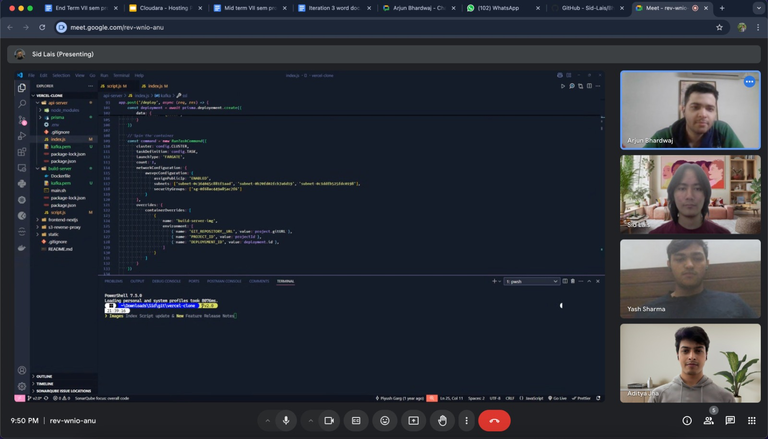
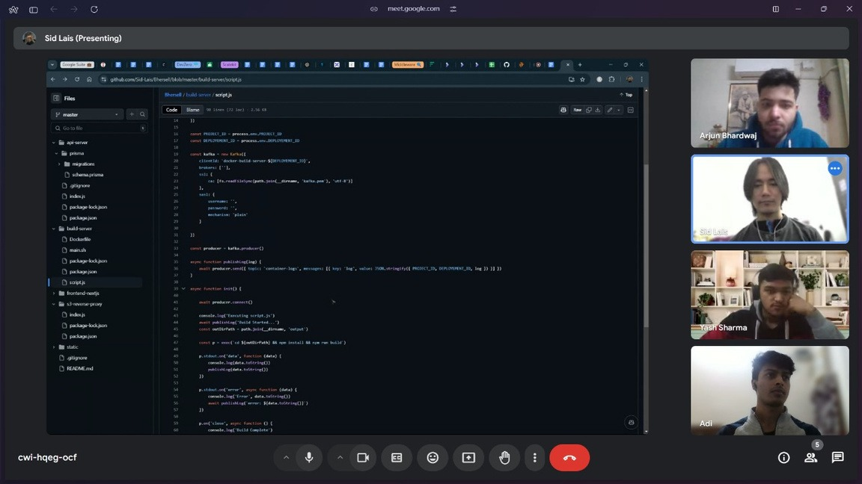
Screenshot of MS-Meetings(online)/comments(offline) by Guide

Slide 25
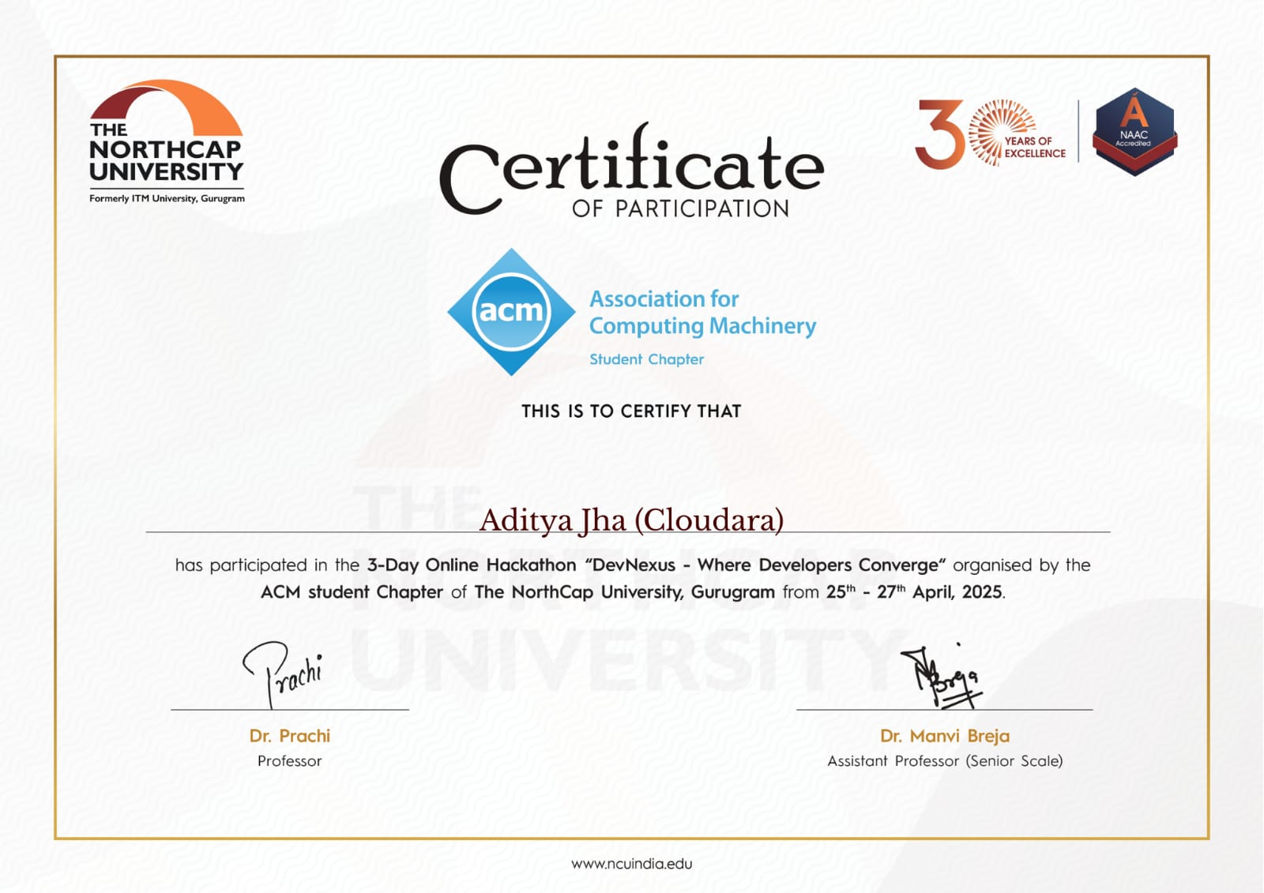



Certificates of DevNexus Hackathon

Slide 26
THANK YOU LET’S MOVE ON TO THE DEMONSTRATION

